Slide 1
HOST BEHAVIOR ANALYSIS FOR PROPERTY RENTAL COMPANY
GROUP MEMBERS-
RITURAJ PAWAR
SURAJ SATPATHY

Slide 2
OBJECTIVE-
Comprehend how host behaviour varies across different metrics in a property rental company.
Finding out top 3 metrics to become a superhost.
How the reviews vary from a superhost to otherhost.
Wheather superhost are tend to have a larger property type as compare to otherhost.

Slide 3
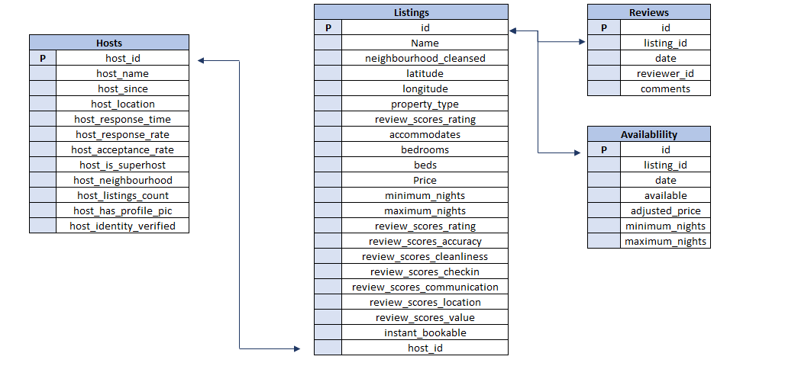
DATA OVERVIEW

Slide 4
COMPARISON OF SUPERHOST VS OTHERHOST ON ACCEPTANCE RATE ON DIFFERENT CITY
Over All Average Acceptance Rate
For City Vancouver
Super host=88.60%
Other host=81.28%
Over All Average Acceptance Rate
For City Venice
Super host=94.43%
Other host=87.45%

Slide 5
COMPARISON OF SUPERHOST VS OTHERHOST ON RESPONSE RATE ON DIFFERENT CITY
Over All Average Response Rate
For City Vancouver
Super host= 98.76%
Other host= 91.61%
Over All Average Response Rate
For City Venice
Super host= 99.08%
Other host= 91.89%

Slide 6
COMPARISON OF SUPERHOST VS OTHERHOST ON LISTING PRICE ON DIFFERENT CITY
Over All Average Listing Price
For City Vancouver
Super host= 171.31$
Other host= 214.33$
Over All Average Response Rate
For City Venice
Super host= 139.24$
Other host= 251.10$

Slide 7
COMPARISON OF SUPERHOST VS OTHERHOST ON REVIEW SCORE ON DIFFERENT CITY
Over All Average Review score
For City Vancouver
Super host= 4.8
Other host= 4.6
Over All Average Review score
For City Venice
Super host= 4.8
Other host= 4.5

Slide 8
COMPARISON OF SUPERHOST VS OTHERHOST ON PROFILE PIC AVAILABILITY ON DIFFERENT CITY
Host Profile Pic Availability
For City Vancouver
Super host= 1776
Other host= 2726
Host Profile Pic Availability
For City Venice
Super host= 2873
Other host= 4445

Slide 9
COMPARISON OF SUPERHOST VS OTHERHOST ON BIG PROPERTY LISTING ON DIFFERENT CITY
Host Big Property Listing
For City Vancouver
Super host= 1481
Other host= 2192
Host Big Property Listing
For City Venice
Super host= 2407
Other host= 3257

Slide 10
COMPARISON OF SUPERHOST VS OTHERHOST ON SMALL PROPERTY LISTING ON DIFFERENT CITY
Host Small Property Listing
For City Vancouver
Super host= 293
Other host= 541
Host Small Property Listing
For City Venice
Super host= 382
Other host= 1067

Slide 11
COMPARISON OF SUPERHOST VS OTHERHOST ON IDENTITY VERIFIED ON DIFFERENT CITY
Host Whose Identity Are Verified
For City Vancouver
Super host= 293
Other host= 541
Host Whose Identity Are Verified
For City Venice
Super host= 382
Other host= 1067

Slide 12
COMPARISON OF SUPERHOST VS OTHERHOST ON IDENTITY NOT VERIFIED ON DIFFERENT CITY
Host Whose Identity Are Not Verified
For City Vancouver
Super host= 89
Other host= 361
Host Whose Identity Are Not
Verified
For City Venice
Super host= 165
Other host= 829

Slide 13
COMPARISON OF SUPERHOST VS OTHERHOST ON INSTANT BOOKING AVAILABLE ON DIFFERENT CITY
Host With Instant Booking Available
For City Vancouver
Super host= 479
Other host= 891
Host With Instant Booking Available
For City Venice
Super host= 2148
Other host= 2903

Slide 14
COMPARISON OF SUPERHOST VS OTHERHOST ON INSTANT BOOKING NOT AVAILABLE ON DIFFERENT CITY
Host With Instant Booking Not Available
For City Vancouver
Super host= 1300
Other host= 1858
Host With Instant Booking Not Available
For City Venice
Super host= 725
Other host= 1574

Slide 15
ANALYSIS ON MONTHLY BOOKING OF SUPERHOST VS OTHERHOST ON DIFFERENT CITY
For City Vancouver The Booking Gradually Increases After Month April And Peak At Month August.
For City Venice The Booking Gradually Increases After Month March And Peak At Month September.

Slide 16
ANALYSIS ON COMMENTS REVIEW OF SUPERHOST VS OTHERHOST ON DIFFERENT CITY
Analysis Of Good Comments Are Based On Most Used Keywords Like-
(GreatLocation,Excellent,Visitagain,Perfect,Love,Good)
Analysis Of Bad Comments Are Based Most Used On Keywords Like-
(Cancelled,Average,Bad,Dissapointed,Dirty)

Slide 17
INSIGHTS-
In our analysis the top 3 crucial metrics one needs to maintain to become a Super Host are Acceptance rate, Response rate, Listing price.
There is no need of big property listing to become a super host as in our analysis the count of big property of other host are greater than super host.
In both Vancouver and Venice super host acceptance rate and response rate is better than other host.
In both Vancouver and Venice super host Listing price is lesser than other host.
Review score for super host of both cities are better than other host.
Super host are having more number of monthly booking than other host for both Vancouver and Venice .
No significant difference between super host and other host in terms of comments by customers.
Keywords used by reviewers for both super host and other host are(GreatLocation,Excellent,Visitagain,Perfect,Good, Cancelled,Average,Bad,Dissapointed,Dirty)

Slide 18
CHALLENGES/LEARNINGS-
CHALLENGES-
Dealing With Huge Data.
Data cleaning.
Dealing with null values/outliers.
LEARNINGS-
Managing Large Dataset.
Writing out Complex Queries.
How To Work In A Team.

Slide 19
Thank You

